Slide 1
SERVERLESS Web APPLICATION WITH LAMBDA, APIGATEWAY AND DYNAMODB
BY
MANJUABHINAYA VR

Slide 2
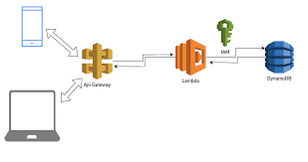
INTRODUCTION
This project demonstrates how to design and implement a serverless web application using AWS Lambda, API Gateway, and DynamoDB — three core services that eliminate the need to manage servers, automatically scale with demand, and reduce operational costs.
The goal of this project is to build a backend API that stores and retrieves data efficiently, while exploring how AWS services integrate seamlessly in a real-world cloud architecture.

Slide 3
OBJECTIVE
To design a serverless architecture that handles API requests and stores data.
To understand integration between AWS Lambda, API Gateway, and DynamoDB.
To deploy and test a functional backend on AWS Free Tier.

Slide 4
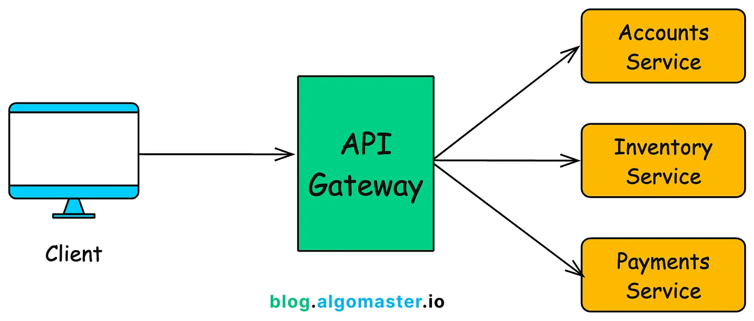
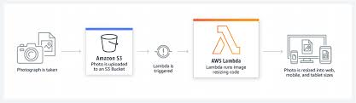
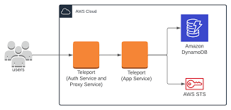
AWS SERVICES USED
API GATEWAY
LAMBDA
DYNAMODB

Slide 5
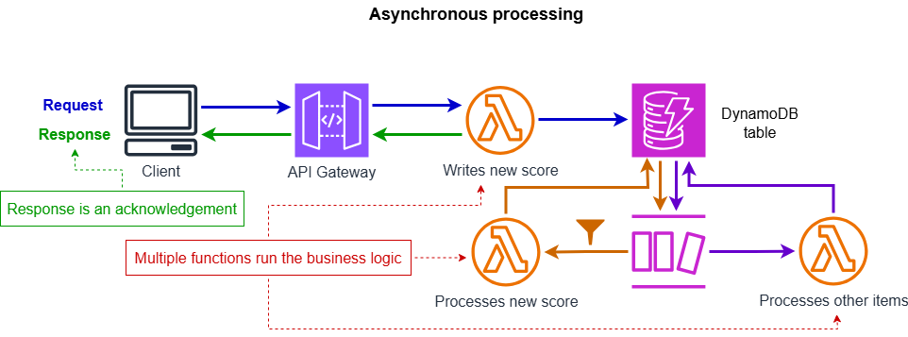
Workflow Explanation

Slide 6
Implementation Steps
Step 1: IAM Role Creation
Created a custom IAM role with the required permissions for Lambda and DynamoDB access. This ensures secure and controlled access between AWS services.
-----------------------------------------------------------------------------------------------------------------------------------------------------------------------
Step 2: Lambda Function Setup
Created a Lambda function and uploaded the web application backend code containing logic for handling requests (contact form and success page). Configured the Lambda function with the IAM role to enable data storage and retrieval in DynamoDB.
-----------------------------------------------------------------------------------------------------------------------------------------------------------------------
Step 3: DynamoDB Table Creation
Set up a DynamoDB table to store user-submitted data from the web application. Defined a primary key for efficient record management.
-----------------------------------------------------------------------------------------------------------------------------------------------------------------------
Step 4: API Gateway Configuration
Created a REST API in API Gateway and integrated it with the Lambda function. Added HTTP methods (GET, POST) to handle incoming requests. Deployed the API and generated the Invoke URL for testing.
-----------------------------------------------------------------------------------------------------------------------------------------------------------------------
Step 5: Testing the Application
Tested the API endpoint using the Invoke URL, which successfully triggered the Lambda function and stored data in DynamoDB. Verified the output through both API Gateway console and DynamoDB records.

Slide 7
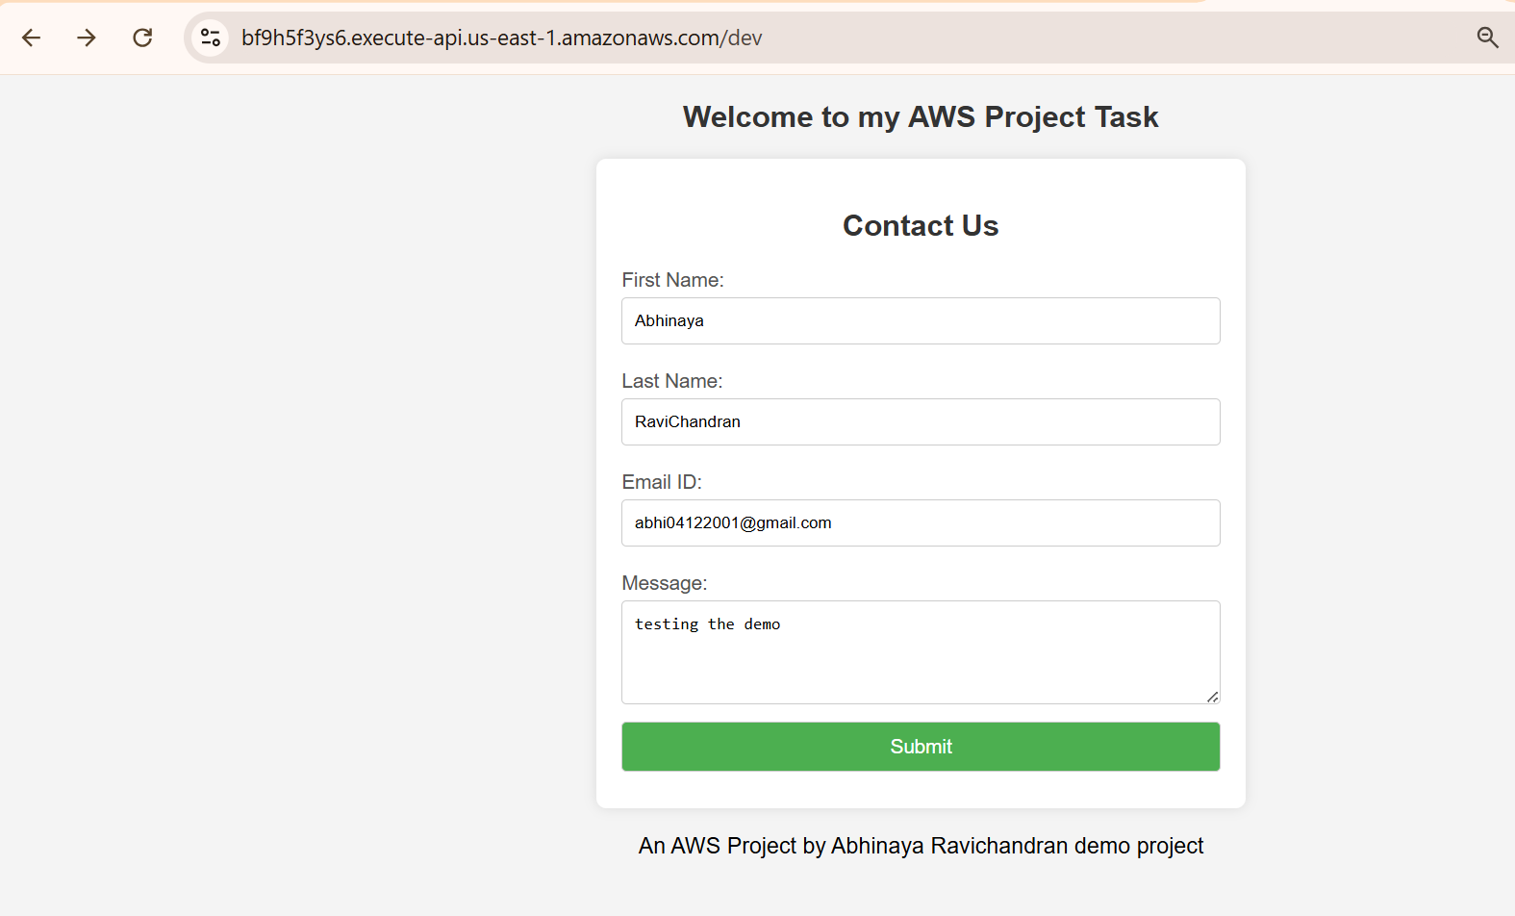
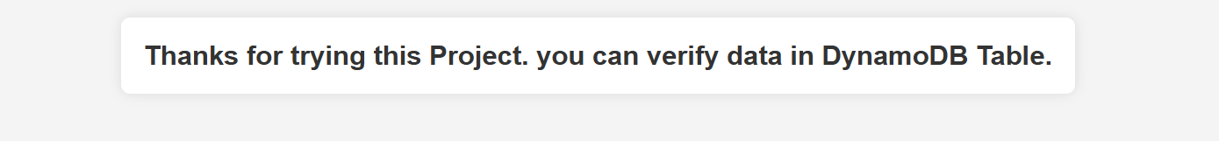
Application Output and API Response

Slide 8
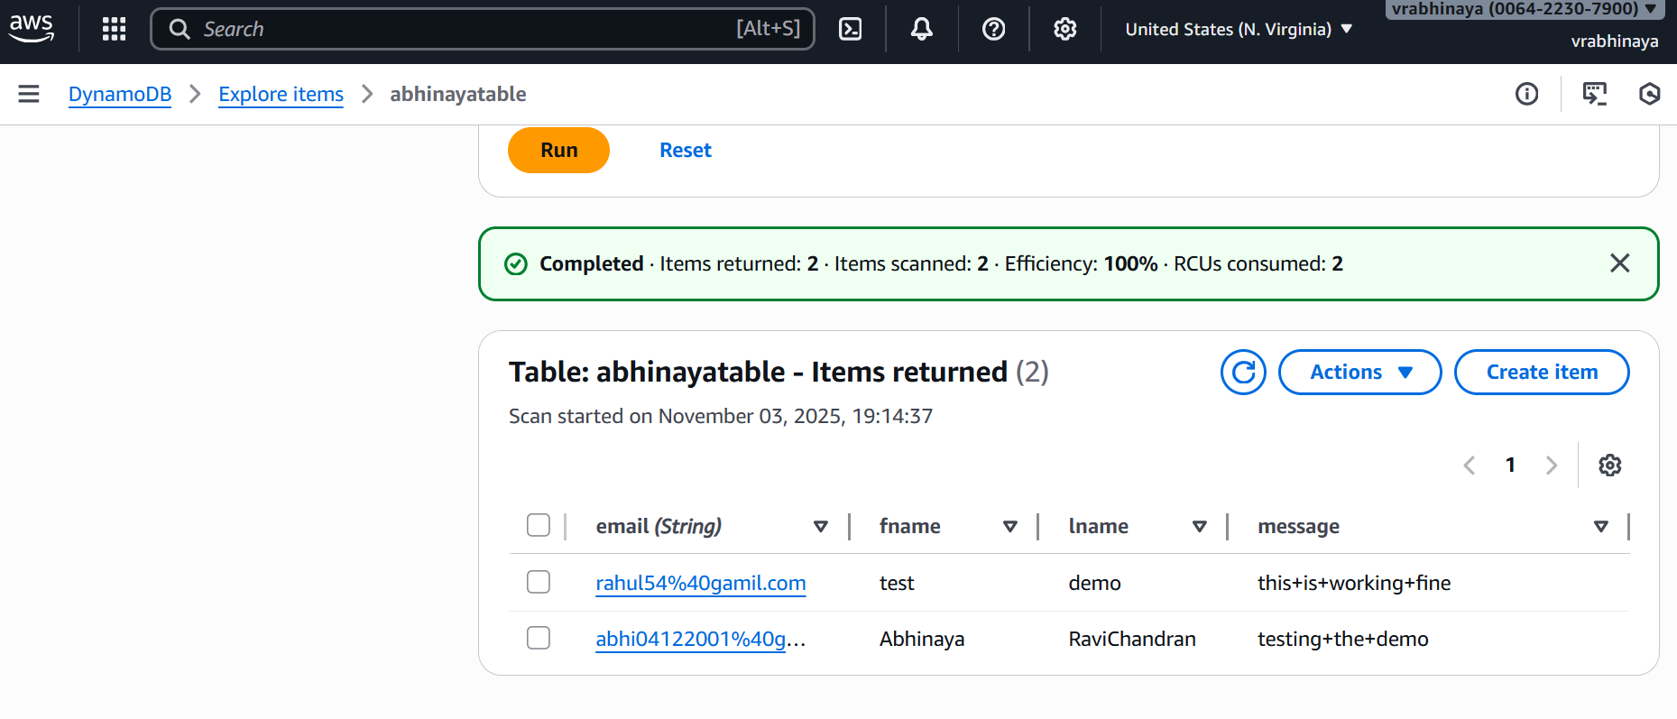
Verified the output through both API Gateway console and DynamoDB records.

Slide 9
LET’S SEE THE Live Demo

Slide 10
THANKYOU

